Slide 1
BEIT: BERT Pre-Training of Image Transformers
Hangbo Bao†∗, Li Dong‡ , Songhao Piao† , Furu Wei‡
† Harbin Institute of Technology
‡ Microsoft Research https://aka.ms/beit

Slide 2
Motivation
Transformer has achieved promising performance in computer vision,but vision Transformers require more training data than CNN.
——self-supervised pre-training
BERT has achieved great success in natural language processing,but it’s challenging to directly apply BERT style pre-training for image data.
Previous VIT-based pre-training methods are mostly based on pixel-level recovery tasks, which may waste model capacity.
-Pre-training of VIT models by masked image modeling (MIM).

Slide 3
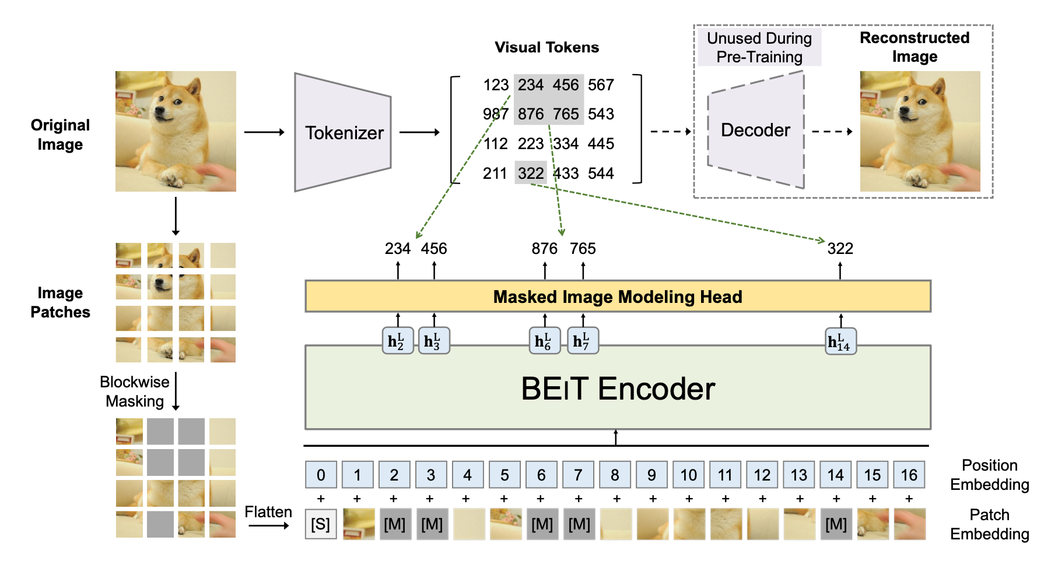
Methods
dVAE + VIT-based MIM（Masked Image Modeling)

Slide 4
Image Representations
-Image Patch reshape the image into patches
224 × 224(image) → 14 × 14(patch) patch: 16 × 16
-Visual Token
tokenizer
decoder
reconstruction objective:
vocabulary V contains discrete token indices. |V| = 8192

Slide 5
Backbone Network: Image Transformer
Input: a sequence of image patches
→
input vectors:
Encoder: L layers of Transformer blocks (l = 1, . . . , L)
output vectors: is the vector of the i-th image patch.
Pre-Training BEIT: Masked Image Modeling
randomly mask some percentage of image patches, and then predict the visual tokens that are corresponding to the masked patches.
Masked patch → token < M >

Slide 6
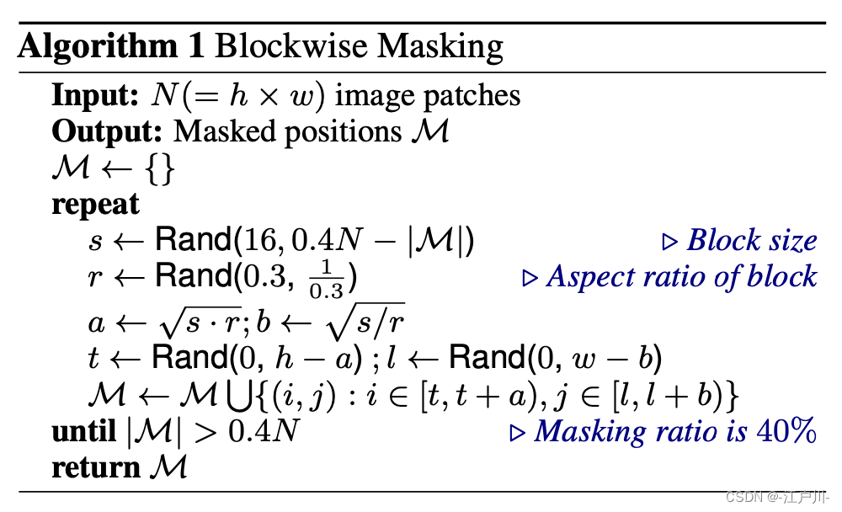
Blockwise Masking

Slide 7
Fine-Tuning BEIT on Downstream Vision Tasks
Image classification.
Semantic segmentation.
Intermediate fine-tuning.

Slide 8
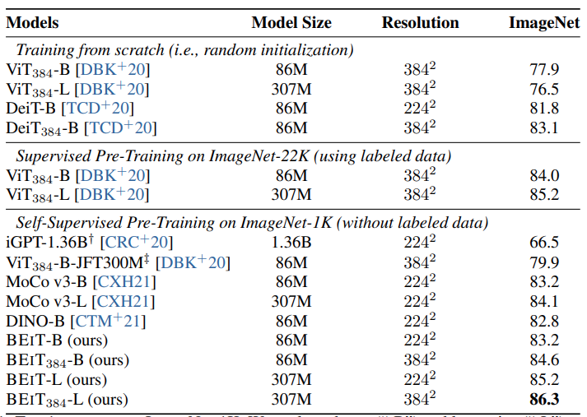
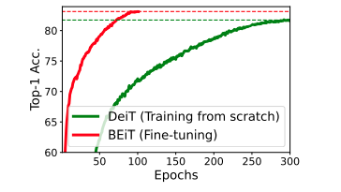
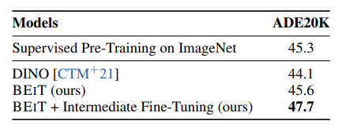
Experiments
Image Classification
Semantic Segmentation

Slide 9
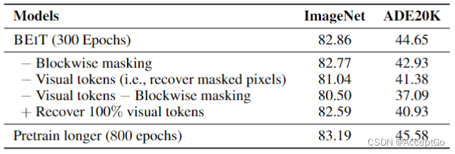
Ablation Studies

Slide 10
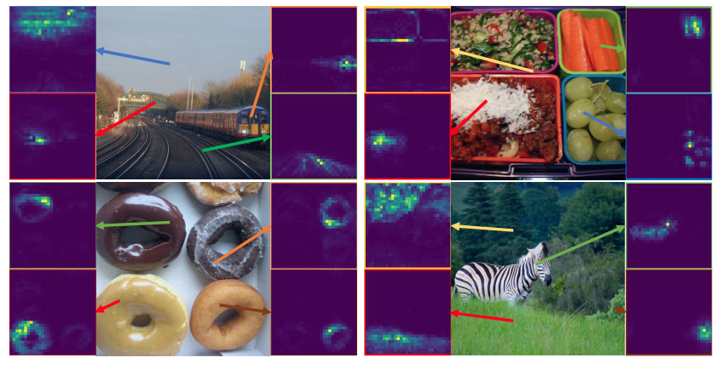
Self-attention map

Slide 11
BEIT V2: Masked Image Modeling with Vector-Quantized Visual Tokenizers
Zhiliang Peng1∗, Li Dong2, Hangbo Bao2, Qixiang Ye1, Furu Wei2 University of Chinese Academy of Sciences1
Microsoft Research2 https://github.com/microsoft/unilm

Slide 12
Motivation
the main difference between previous work lies in the reconstruction targets (visual tokens,raw pixels,hand-crafted HOG features)
recovering low-level supervision tends to waste modeling capacity on pretraining high-frequency details and short-range dependencies
the masked words in language modeling are usually supposed to have more semantics than pixels.
The MIM method can only complete the reconstruction of patch, and lacks the learning of CLS token
-Exploiting semantic-aware supervision during pretraining.

Slide 13
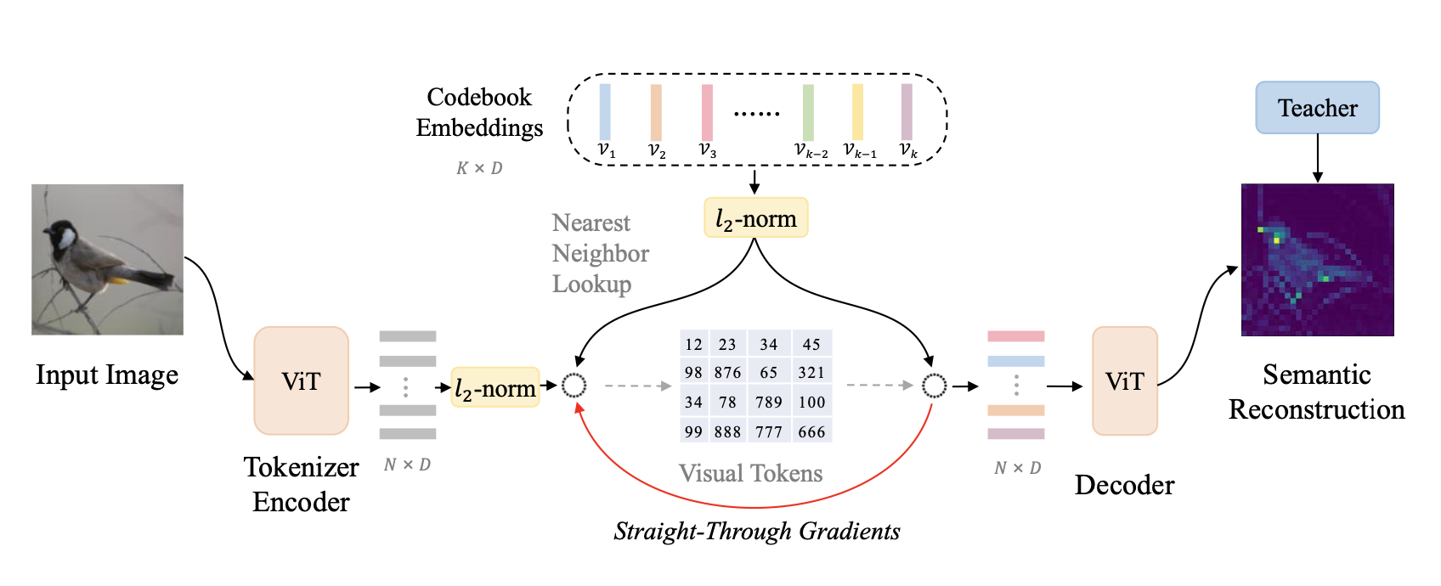
Methods
Image Representations
Training Visual Tokenizer propose vector-quantized knowledge distillation (VQ-KD) to train the visual tokenizer

Slide 14
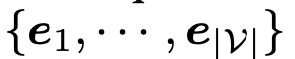
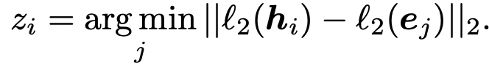
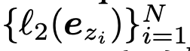
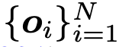
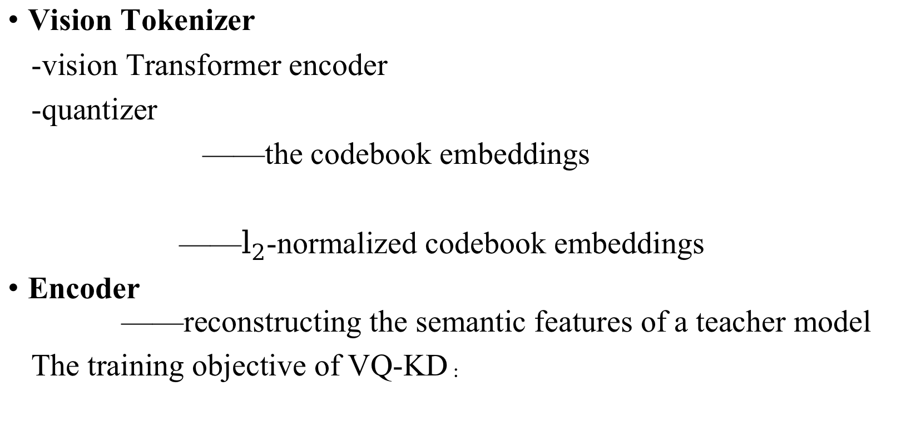
Vision Tokenizer
-vision Transformer encoder
-quantizer
——the codebook embeddings
——$l_{2}$-normalized codebook embeddings
Encoder ——reconstructing the semantic features of a teacher model
The training objective of VQ-KD：

Slide 15
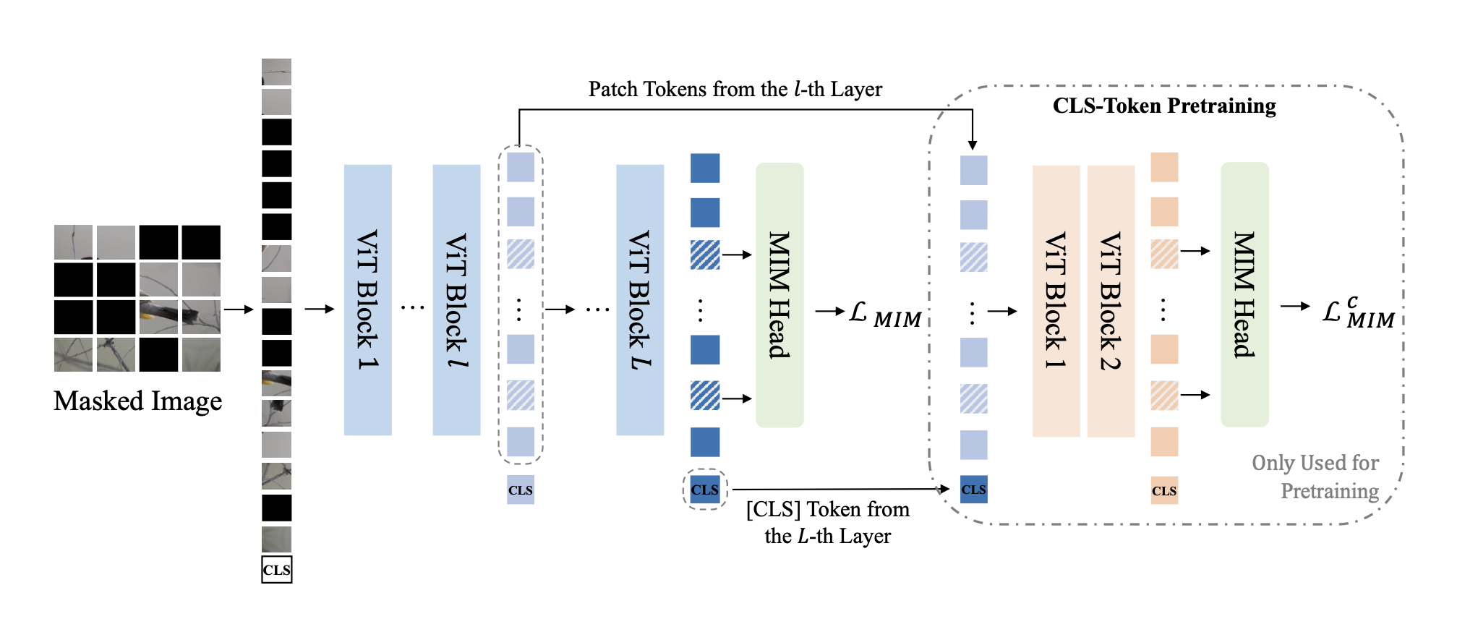
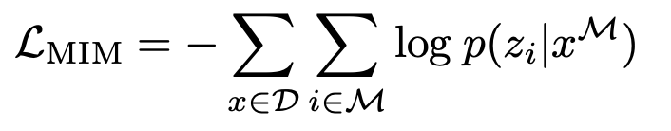
Pretraining BEIT V2
-pretrain the CLS token for global representation

Slide 16
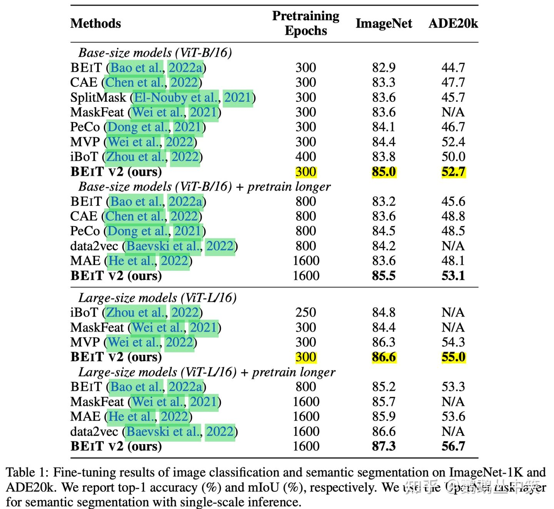
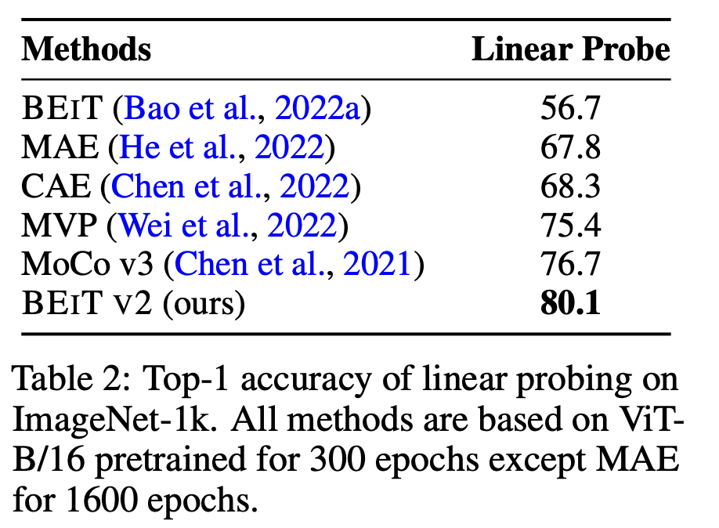
Experiments
Semantic Segmentation
Image Classification

Slide 17
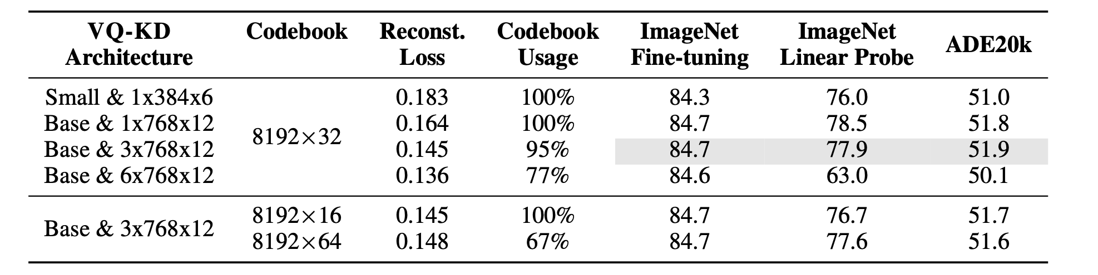
Ablation Studies

Slide 18
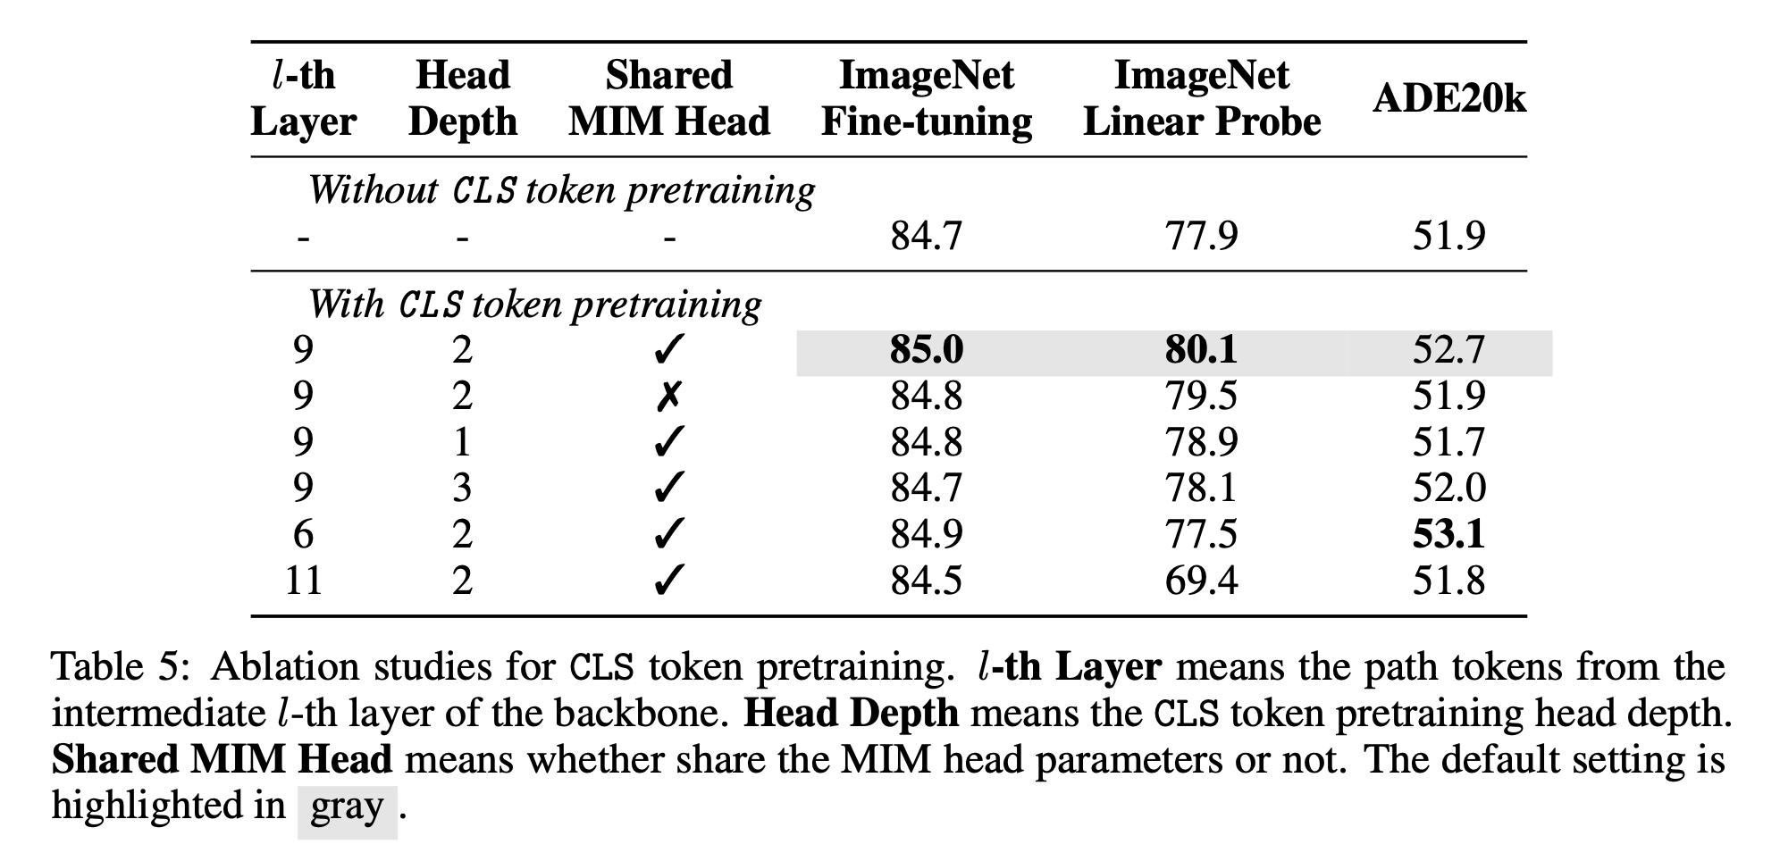
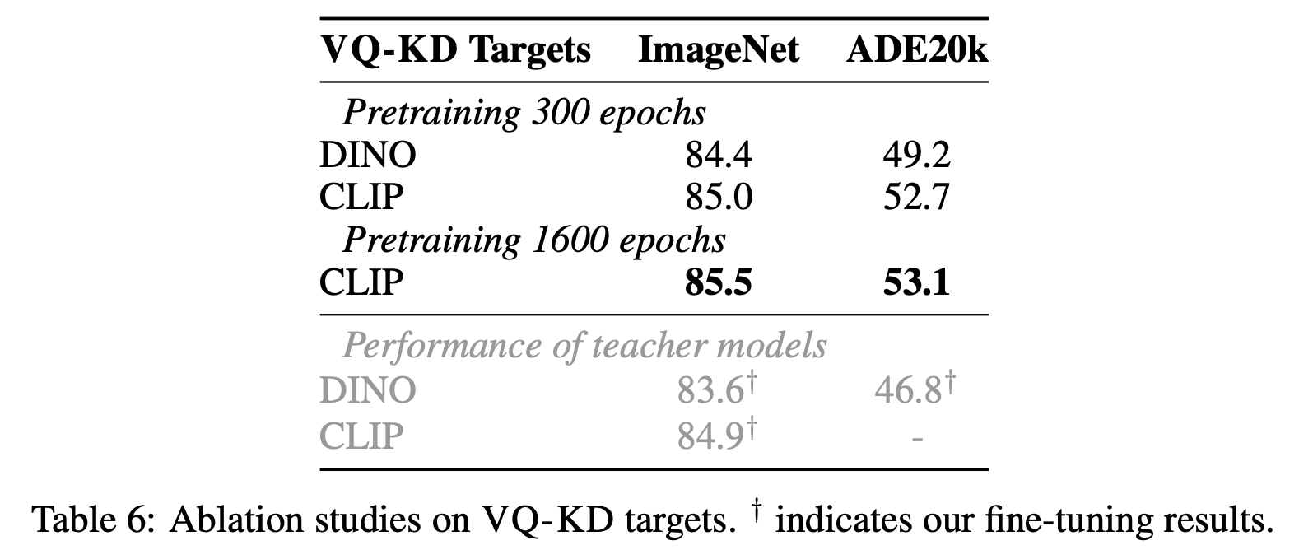

Slide 19
Image as a Foreign Language: BEIT Pretraining for All Vision and Vision-Language Tasks
Wenhui Wang∗, Hangbo Bao∗, Li Dong∗, Johan Bjorck, Zhiliang Peng, Qiang Liu
Kriti Aggarwal, Owais Khan Mohammed, Saksham Singhal, Subhojit Som, Furu Wei†
Microsoft Corporation
https://aka.ms/beit-3

Slide 20
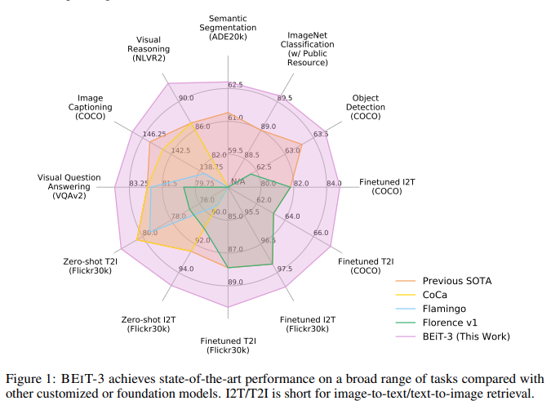
Introduction
big convergence - language -vision -multimodal pretraining

Slide 21
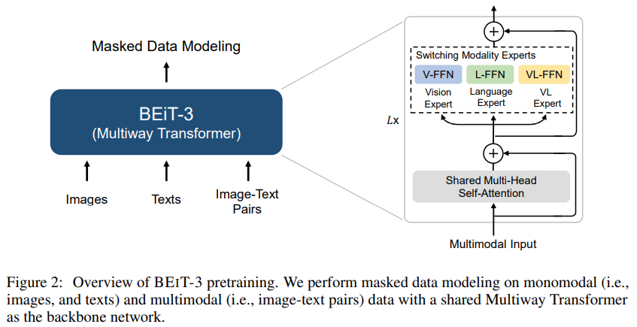
Method
Backbone Network: Multiway Transformers -Multiway Transformers -self attention -modality experts (feed-forward network)

Slide 22
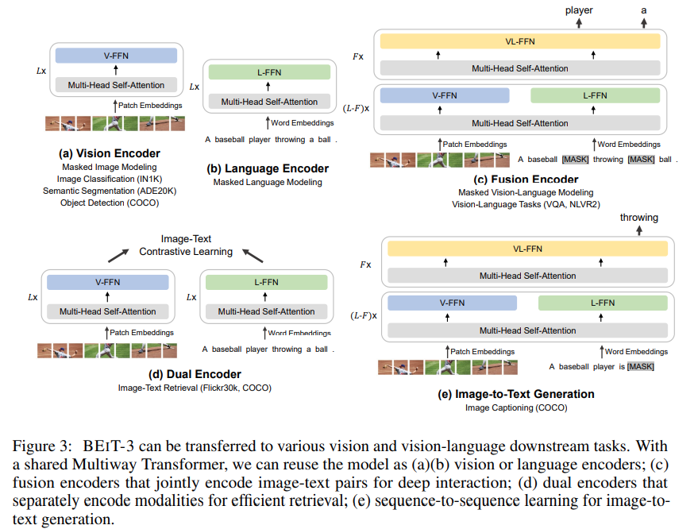
Method
Backbone Network: Multiway Transformers

Slide 23
Method
Pretraining Task: Masked Data Modeling -masked data modeling a. randomly mask some percentage of text tokens or image patches
b. train the model to recover the masked tokens. 15% tokens of monomodal texts 50% tokens of texts from image-text pairs mask 40% of image patches using a block-wise masking strategy as in BEIT text data —— tokenized by a SentencePiece tokenizer image data —— tokenized by the tokenizer of BEIT v2

Slide 24
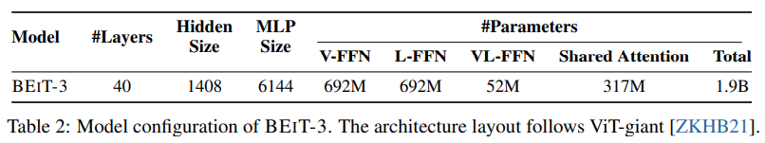
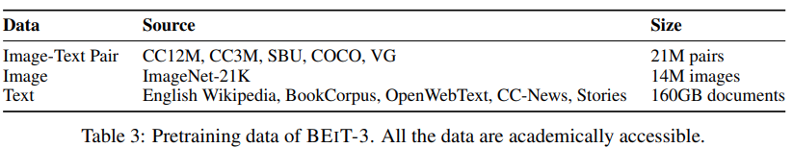
Method
Scaling Up: BEIT-3 Pretraining -Backbone Network -Pretraining Data -Pretraining Settings pretrain BEIT-3 for 1M steps. Each batch contains 6144 samples in total, including 2048 images, 2048 texts and 2048 image-text pairs.

Slide 25
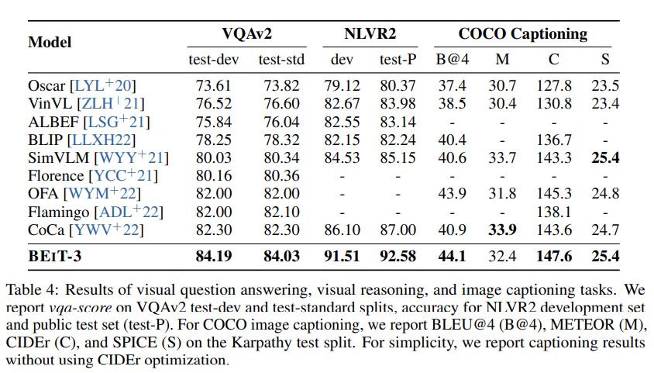
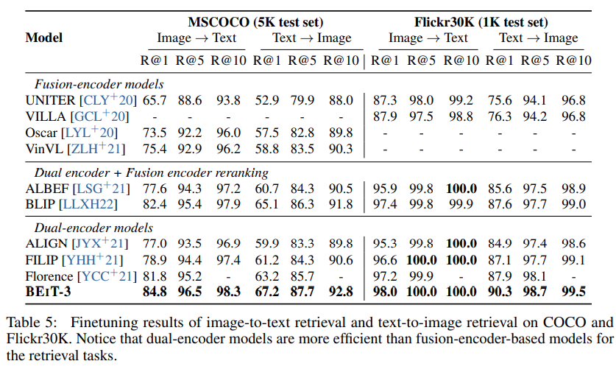
Experiments

Slide 26
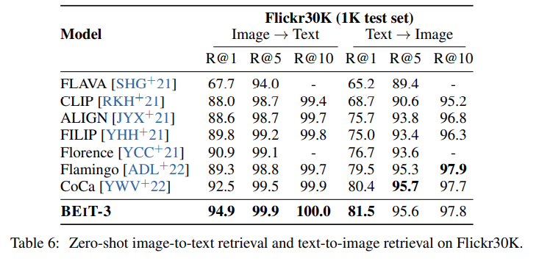
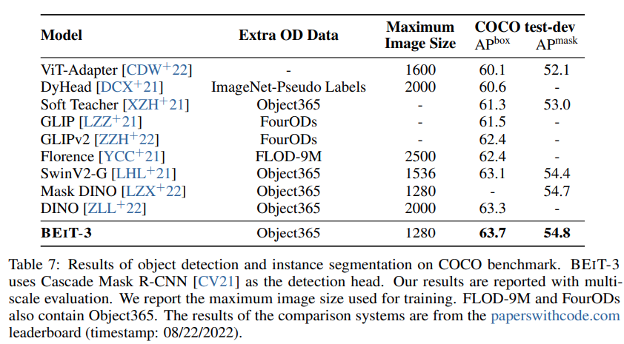
Experiments

Slide 27
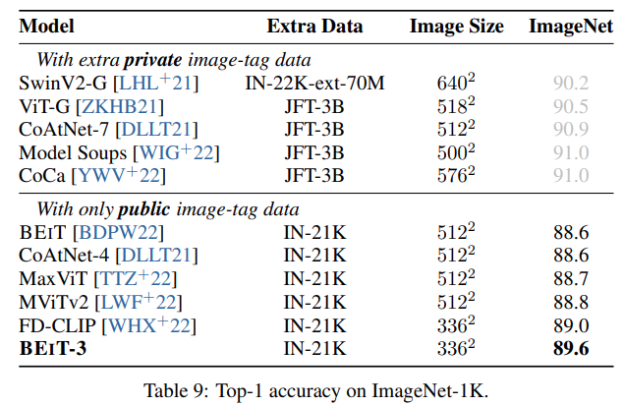
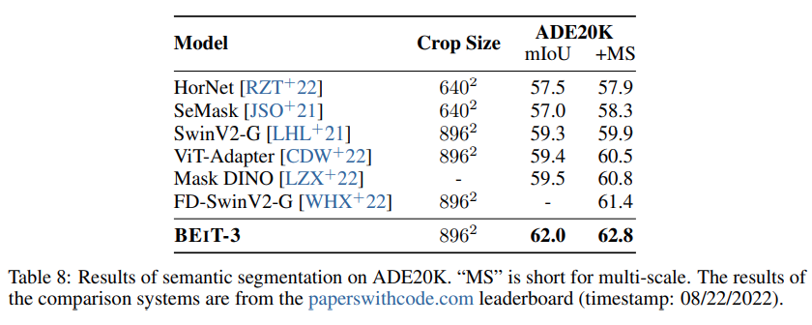
Experiments

